Slide 1
Docker Best Practices
Docker Indy 25-Aug-2015
Matt Bentley
@matthewbentley

Slide 2
Topics - Docker Best Practices
Deploying Docker Engines
CLI Tips and Tricks
Building Efficient Dockerfiles
Questions

Slide 3

Deploying Docker Engines
Should I use…
Docker or run native?
Docker on Bare Metal?
Docker in VMs?

Slide 4
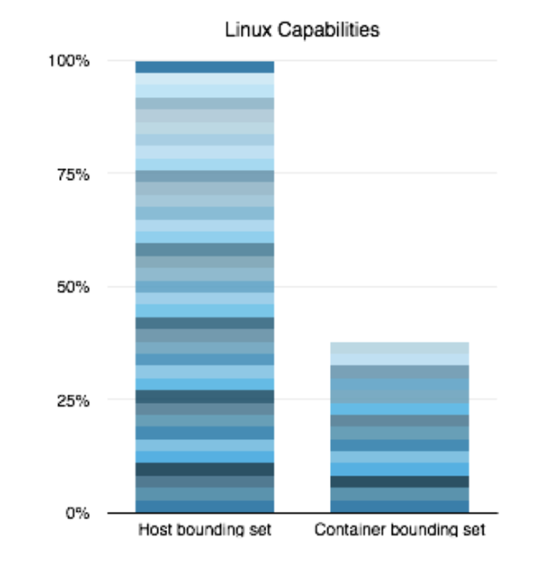
Docker or not?
Docker containers have reduced capabilities
Less than half of the capabilities of normal processes by default
Reduced capabilities help mitigate impact of escalation to root
Software vendor support?
Meet system requirements/tuning?

Slide 5
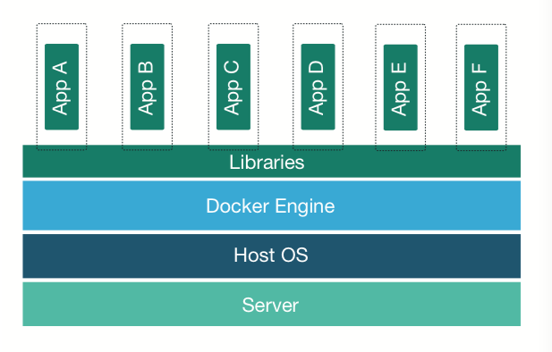
Docker on Bare Metal?
Strong Isolation features
Protects the host from malicious applications
Protects applications from each other
Fine grained per-application permissions
No hardware support (VT-d and VT-x)
Makes applications stronger by default
Applications running on bare metal
Applications running on the same security zones

Slide 6
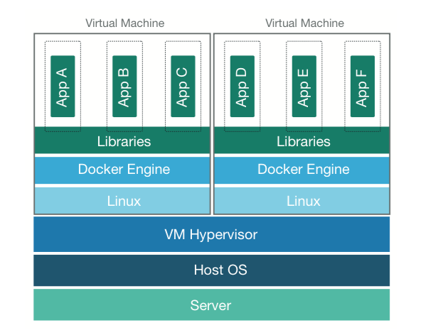
Docker on VMs?
Best of both worlds
Allows the reduction of total number of VMs
Gives all of the benefits of Docker flexibility/portability
Stronger Application Isolation
Defense-in-depth
Malicious code has to escape both isolation mechanisms

Slide 7
CLI Tips and Tricks
Remove Container and Docker Managed Volumes
docker rm -v <container-id-or-name>
Cleanup Exited Containers
docker rm -v $(docker ps -f status=exited -qa)
Cleanup Untagged Images
docker rmi $(docker images --filter "dangling=true” -q)

Slide 8
CLI Tips and Tricks (Continued)
Real time stats from all running containers
docker stats $(docker ps -q)
Start another process in a running container
docker exec -it <container-id-or-name> <command>
Run a container with the root file system mounted read-only
docker run --read-only…

Slide 9
CLI Tips and Tricks (Continued)
Run Docker Bench to test your host and running containers:
docker run -it --net host --pid host --cap-add audit_control -v /var/lib:/var/lib -v /var/run/docker.sock:/var/run/docker.sock -v /usr/lib/systemd:/usr/lib/systemd -v /etc:/etc --label docker_bench_security docker/docker-bench-security
https://dockerbench.com

Slide 10
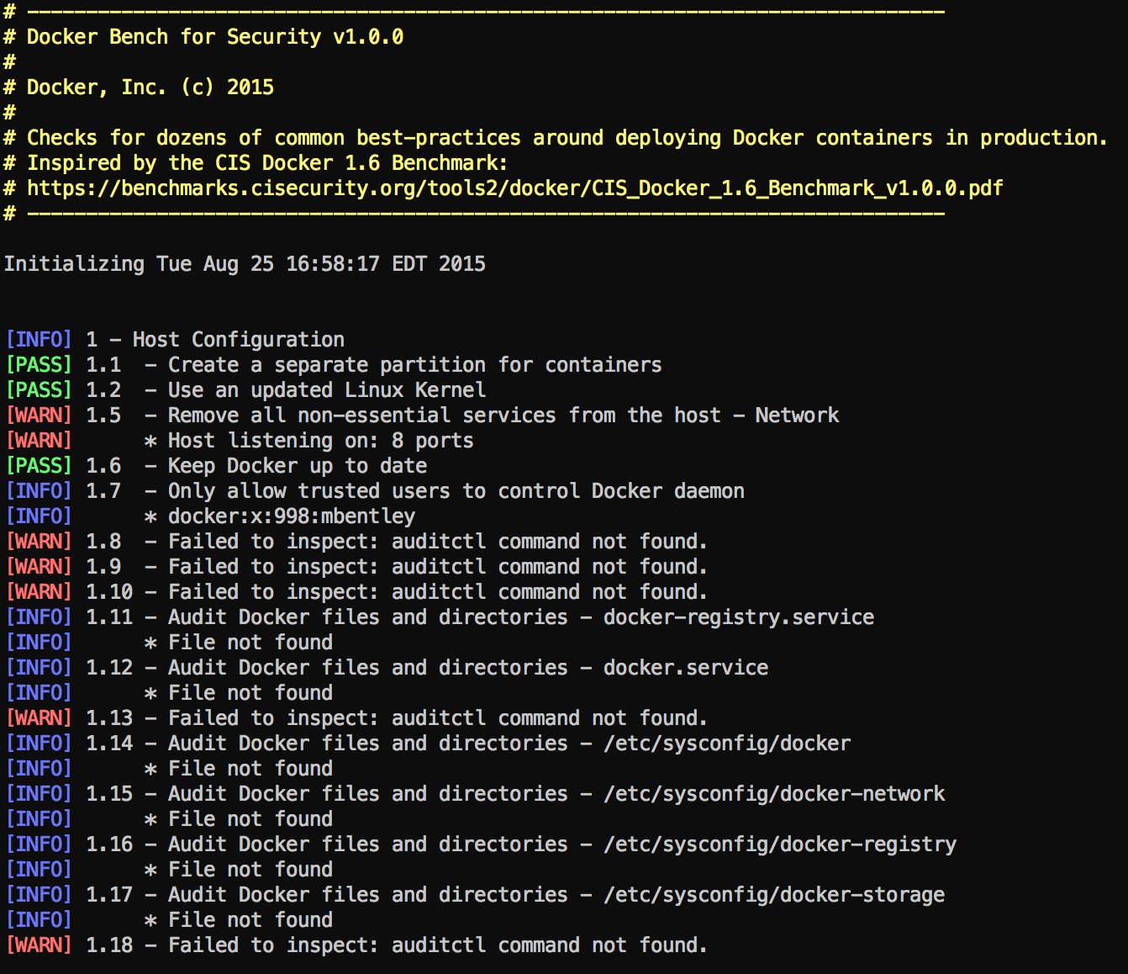
Docker Bench Demo

Slide 11
Building Efficient Dockerfiles
Utilize minimal Linux distributions
Alpine Linux
Build from scratch
Only install what you need
Smaller footprint & attack service
Run one process per container
Easier to scale and re-use images
Run processes as non-root whenever possible

Slide 12
Building Efficient Dockerfiles (Continued)
Utilize a hierarchical order of images
debian
java
grails
tomcat
appA
appB
nodejs
appA
appB
nginx
writeable layer
appA
tomcat
java
debian

Slide 13
Building Efficient Dockerfiles (Continued)
Minimize the number of layers
Combine like RUN commands to a single command
Bad!
Good!
RUN apt-get update
RUN apt-get install -y wget
RUN rm -rf /var/lib/apt/lists/*
RUN apt-get update &&\
apt-get install -y wget &&\
rm -rf /var/lib/apt/lists/*

Slide 14
Building Efficient Dockerfiles (Continued)
Optimize image size
Remove caches and archives during a single RUN command so they are not included in your final image
RUN wget -O /tmp/tomcat7.tar.gz http://www.us.apache.org/dist/tomcat/tomcat-7/v7.0.63/bin/apache-tomcat-7.0.63.tar.gz &&\
cd /opt &&\
tar zxf /tmp/tomcat7.tar.gz &&\
mv /opt/apache-tomcat* /opt/tomcat && \
rm /tmp/tomcat7.tar.gz

Slide 15
Building Efficient Dockerfiles (Continued)
Better optimize builds to utilize layer caching
Separate changes that break the cache
Bad!
Good!
COPY . /usr/src
RUN npm install
COPY package.json /usr/src/package.json
RUN npm install
COPY . /usr/src

Slide 16
Topics - Docker Best Practices
Deploying Docker Engines
CLI Tips and Tricks
Building Efficient Dockerfiles
Questions

Slide 17
…but wait! There’s more!
Windows Server 2016 Technical Preview 3
Includes Docker Windows Containers Support
https://msdn.microsoft.com/virtualization/windowscontainers/containers_welcome

Slide 18

Stop, demo time!
https://github.com/mbentley/docker-windows-containers-examples

Slide 19
Questions?

